Slide 1
Simplifying expressions involving index laws
EQ: How do you simplify expressions using the index laws

Slide 2
Learning Intentions
Students will be able to
Simplify expressions using the index laws

Slide 3
24
7
30
Simplifying expressions using index laws
Date:
EQ – How do you simplify expressions using the index laws?
Turn to shoulder partner: 30 sec to come up with a sentence/saying to remember how do you simplify expressions in algebra?
HINT: Turn back to the second lesson in your INB
This is where you can also use 1 min to add your last couple of lessons into your contents page. ARE YOU GIVING YOUR 100%
DISCUSSION AND PURPOSEFUL NOTETAKING- From the discussion write your definition of simplifying expressions
GUESS WHAT!!!!!!!
You can use index laws when simplifying expressions involving multiplication and division
Notes:
Students answers will probably be about collecting like terms
Make a connection that this is when expressions have addition and subtraction.
What about expressions that have multiplying and dividing? Does the same rule (like terms) apply?

Slide 4
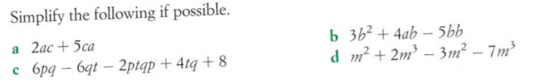
24
7
30
Simplifying expressions using index laws
Date:
EQ – How do you simplify expressions using the index laws?
Rule up 2 column notes as you will be writing hints to yourself. You are also going to need a second piece of lined paper to glue into your notes side of Cornell notes. GIVE YOUR 100%
Example 1- We have done similar one already. COLLECT LIKE TERMS
BUT WHAT ARE LIKE TERMS????
Example/Question | Hints

Slide 5
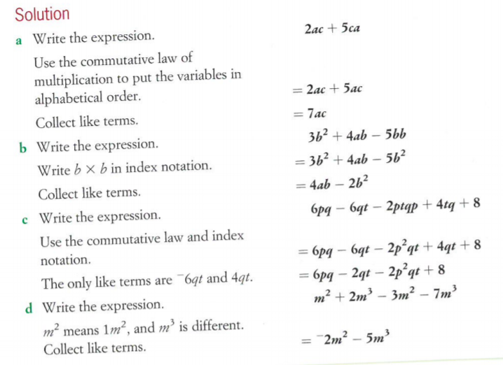

Slide 6
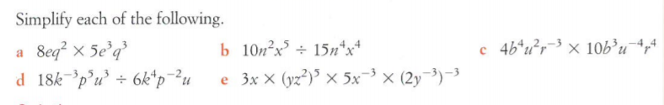
24
7
30
Simplifying expressions using index laws
Date:
EQ – How do you simplify expressions using the index laws?
Example 2- Now expressions involving multiplying. KEEP YOUR 2 COLUMN NOTES AND GET SPARE PAPER AND ORIGAMI IT ON YOUR NOTES PAGE
Example/Question | Hints

Slide 7
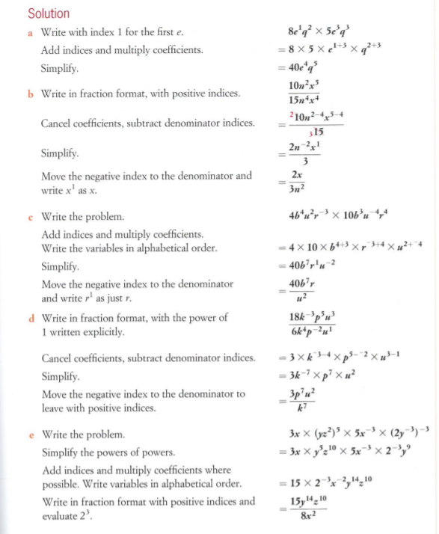

Slide 8

24
7
30
Simplifying expressions using index laws
Date:
EQ – How do you simplify expressions using the index laws?
Example 2- Now expressions involving dividing. KEEP YOUR 2 COLUMN NOTES AND GET SPARE PAPER AND ORIGAMI IT ON YOUR NOTES PAGE
Example/Question | Hints

Slide 9
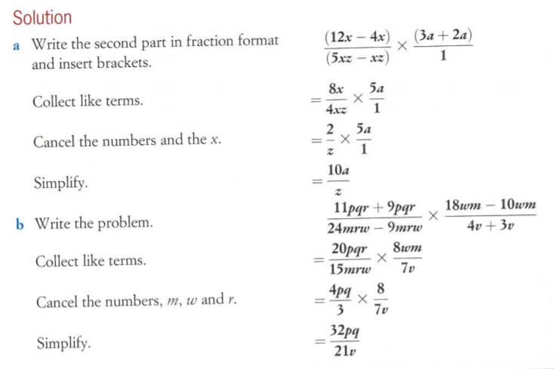

Slide 10
YOUR TURN: Grab the Nelson Yr 10 textbook
On your left hand side you will write Ex3.1 p85
Complete Q4 m, n,o
Complete Q5 d, I
Complete Q6 a, b, c, m, n
Complete Q10b, c, g, h, m, n
Complete Q14 e, g,I, n, p, q
Complete Q16 a, b
Complete Q19 a, b ( B grade questions)

